Slide 2
COMMUNITY
ORGANIZING

Slide 3
Institutions
Power
Reflection
Assessment
Relational
Meetings
Cycle
Of
Organizing
Action
House
Meetings
Research
Core Teams

Slide 5
Pressing Social Problems

Slide 6
Usually Complex

Slide 7
Hence, engage diverse set of people

Slide 8
Organizing values diversity

Slide 10
Community organizing is about building a stronger and more responsive---

Slide 11
In democratic societies, citizens have---

Slide 12
As citizens become involved they exercise power, develop into the leaders, and create tangible---

Slide 14
Community organizing is fundamentally rooted in democratic ---

Slide 16
“Never do for others what they can do for themselves.”

Slide 17
Organizing develops the extraordinary capacities of ordinary citizens to lead their communities into---

Slide 18
Organizers never assume they know what is best for a community.

Slide 19
Organizing values the knowledge and wisdom that comes from lived ---

Slide 20
We participate with a community but we never do things for a community

Slide 21
“Doing for” may lead to further disempowerment and oppression.

Slide 22
of the community organizing process

Slide 25
Built on understanding our own and the community's privilege, oppression, and identity (P0I), and self-interest.

Slide 26
One-to-Ones and House Meetings

Slide 27
Agitation

Slide 28
Identify the collective self-interest

Slide 30
Issue Selection

Slide 31
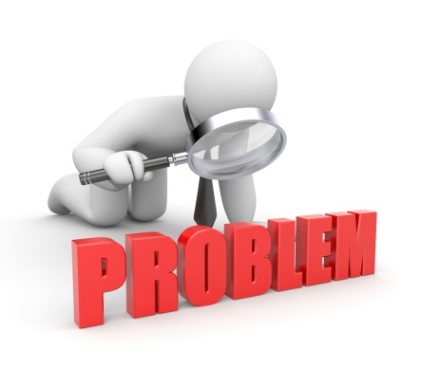
Identifying a problem within the community that leads to injustice.

Slide 32
Selecting a bite-size portion of it, or issue, to work on together.

Slide 33
We focus on the world as it is while working toward creating

Slide 34
We build on the self-interest of community members to select issues.

Slide 36
Issue Research

Slide 37
Includes collecting information: traditional, experiential, and relational, about the issue chosen.

Slide 38
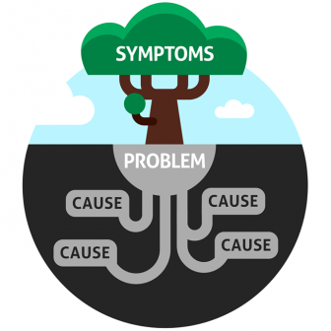
Focus on identifying the root causes of the chosen issue

Slide 39
Develop a power map.

Slide 40
Determining the power, systems, and structures related to the selected issue

Slide 43
In this phase, organizers develop and implement a plan

Slide 44
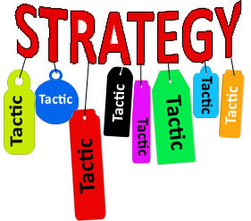
Development of a strategy and associated tactics for creating change.

Slide 45
Based on the relationships built and the information gathered.

Slide 47
Reflection & Assessment

Slide 48
The community critically reflects on its progress and assesses ways to improve strategies and plans for future actions.

Slide 49
A celebration is held to recognize accomplishments

Slide 50
In Community Organizing

Slide 51
Not about the short-term mobilization of bodies, protests, or rallies.

Slide 52
Organizing is about achieving long-term change through building powerful, public relationships; influencing and negotiating with government, corporations, and institutions.

Slide 54
Holding decision-makers accountable to the people

Slide 55
Advocates often address issues on behalf of marginalized groups.

Slide 56
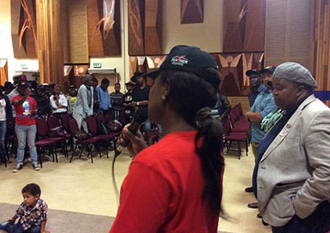
Organizers provide the venue for communities to speak for themselves.

Slide 57
Activism focuses on issues

Slide 58
Organizers focuses on values that drive interest in creating change.

Slide 59
Service providers supply immediate needs in the short-term.

Slide 60
Organizing focuses on understanding root causes.

Slide 61
A community experiences a lack of affordable housing

Slide 62
Outsides might be involved in lobbying for more affordable housing, creating awareness of the issue, and educating the public about it yet, stakeholders may or may not be involved.
Advocacy:

Slide 63
Mobilizing could include having community meetings with stakeholders about the lack of housing. The focus of these meetings would be on the current issue: lack of affordable housing.
Mobilizing:

Slide 64
Activism could include things such as public awareness campaigns to draw attention to the housing issue and hopefully instigate a social or policy change to increase affordable housing options.
Activism:

Slide 65
Providing service could include individuals helping to secure temporary housing for those that need it in places such as shelters.
Providing Service:

Slide 66
Community Organizing:
Community organizing would not only address the current issue but also take a look at the root cause of the housing crisis. For example, the lack of affordable housing could exist in response to discriminatory zoning laws.

Slide 67
Not only would community organizers address the housing crisis, they would also look at challenging these laws to get at the root cause of the issue. This is done by involving stakeholders in addressing how this violates their values of equality and working to resolve this violation as well as the lack of affordable housing.

Slide 72
Assessment
of
Training

